Slide 1

Learn Programming For Kids (Python)

Slide 2
Lesson 6
Python Operators

Slide 3
9. Python Operators
Operators are unique symbols that are used to perform calculations on numbers and other information. They help us add numbers together, compare values, or change the variables’ values.

Slide 4
Python divides the operators into the following groups:
Arithmetic operators (+, -, *, /, %, **, //)
Assignment operators (==, +=, -=, *=, /=, %=, //=, **=, &=, |=, ^=, >>=, <<=)
Comparison operators (==, !=, >, <, >=, <=)
Logical operators (and, or, not)
Identity operators (is, isnot)
Membership operators (in, not in)
Bitwise operators (&, |, ^, ~, <<, >>)

Slide 5
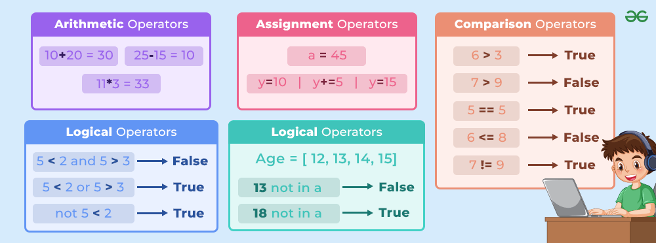

Slide 6
Play with Python Operators:

Slide 7
Example 1: How to Add Two Numbers in Python
Here num1 and num2 are variables and we are going to add both variables with the + operator in Python.

Slide 8
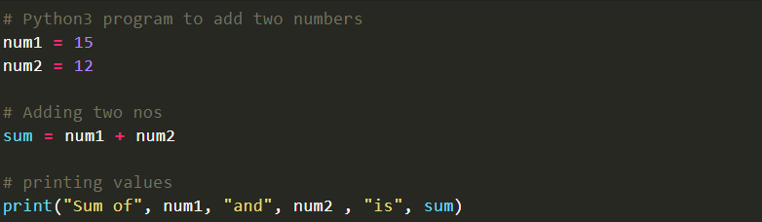
Code:

Slide 9

Output:

